Slide 1
Module 4
Which English?

Slide 2
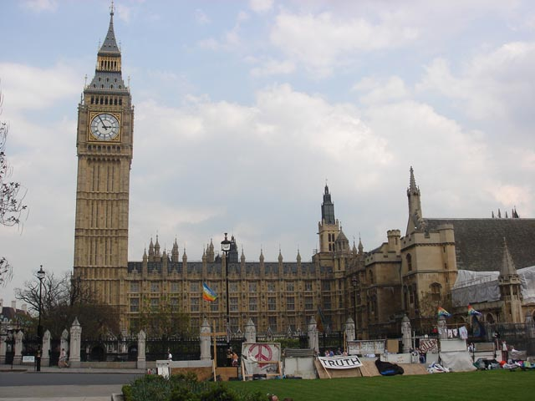
Big Ben
London

Slide 3
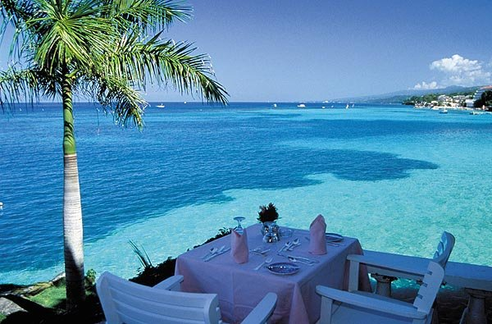
Jamaica

Slide 4
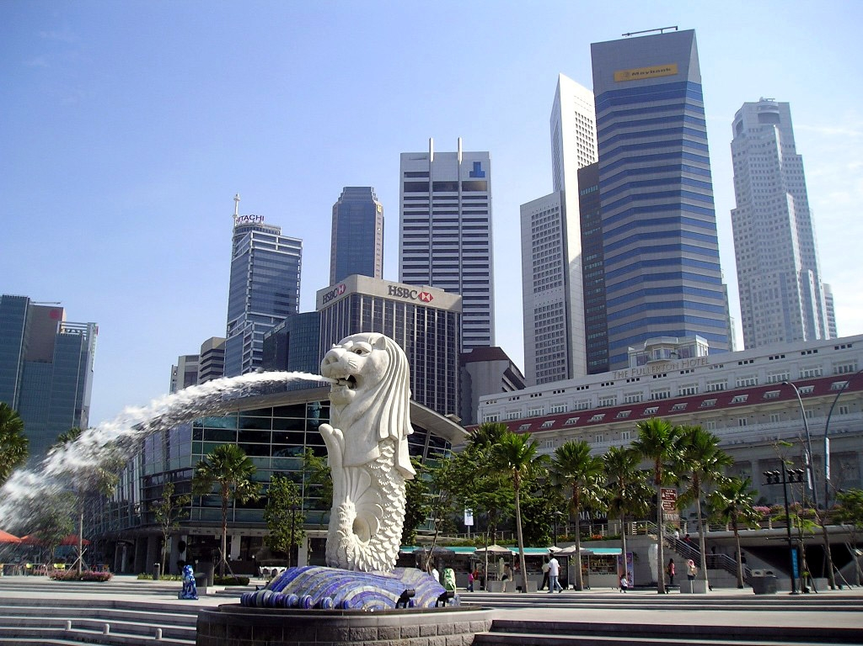
Singapore

Slide 5
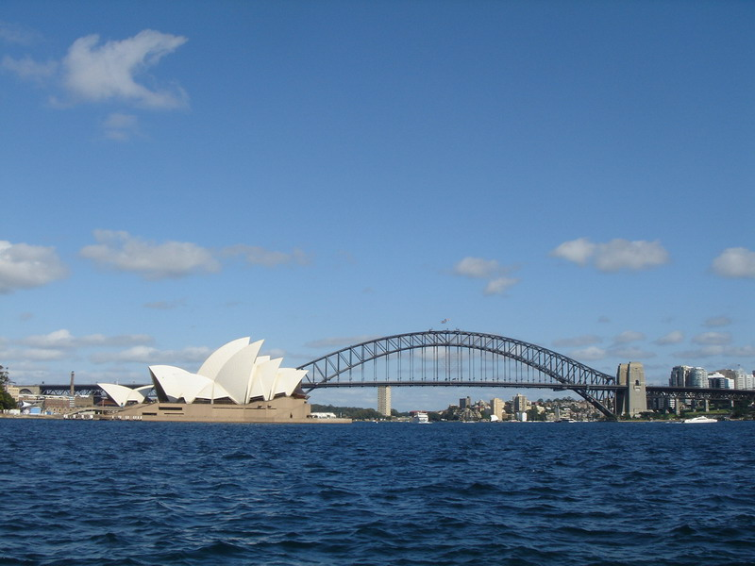
Australia

Slide 6
Look at the content in the box. Listen to the tape and find out which are not mentioned in the passage?
E
F
H
A. the use of language
B. official language
C. pronunciation and grammar
D. different Englishes
E. learning English
F. the development of English
G. the English-speaking country
H. the history of English

Slide 7
Choose the best answers according to the text.
1. According to the writer, you can know who it is when someone phone you because____.
A. this person’s voice is different from others’
B. this person uses different words from others’
C. either A or B
D. both A and B
D

Slide 8
2. We nlearn from the Paragraph 2 all the following except_____.
A. English spoken by people in the different areas sounds different
B. English pronunciation, grammar and vocabulary can change quickly from place to place
C. you can tell which part of the world a person comes from by their accent
D. British English and American English are similar
D

Slide 9
3. There are different Englishes in the world . But it is impossible to tell which English is correct because_____.
A. Most people don’t agree that there is a right or wrong way to speak English
B. the development of English has produced many different Englishes
C. English is widely spoken and it is impossible to provide a model to follow
D. people only pay attention to how they can communicate
c

Slide 10
4. It is not mentioned in Part 2 that Australia is a country ________.
A. where British government once sent its prisoners to work
B. which is one of the youngest nations in the world
C. whose English is sometimes hard to understand for people from other English-speaking countries
D. where there are unusual plants and animals
D

Slide 11
5. In the last part of the text, the writer mainly wants to tell us that _____.
A. the English spoken in a certain country is influenced by the mother tongue of the speakers
B. Jamaica English has features of some African languages
C. many people in Singapore are bilingual
D. Jamaica English and Singapore English are quite different to British English
A

Slide 12
Everyday English
Complete the sentences with the correct forms of the expressions given.
1. It doesn’t matter.
2. a straight answer
3. mate
4. get held up
5. I’ve got no idea

Slide 13
1. ----When is the sports meeting going to be held,do you know?
----________________. You can ask the monitor.
2. ----He missed the plane to Paris.
----On the way to the airport, there had been an accident which resulted in a traffic jam and he ______________________.
3. ----Where is the bus to the History Museum?
----Do you see that building with red bricks, _____? That’s the museum you asked about.
I’ve got no idea
got held up
mate

Slide 14
4. ----Sorry for returning the book late. ----__________________.I wasn’t reading it,acturally.
5. I am still uncertain abiut the manager’s attitude because he didn’t give me _________________ when I asked him his opinions about the matter.
It doesn’t matter
a straight answer

Slide 15
Reading And Vocalbulary
Skim the passage to decide the main idea of each paragraph.
Paragraph One
A. English has a powerful influence in the world.
B. The communication revolution has turned the world into a “global village.”
C. English has spread around the world because of the communication revolution.
A

Slide 16
Paragraph Two
A. More people now speak English as a second language.
B. British English is only one variety.
C. Experts believe that the future shape of English will no longer be determined by the traditional English-speaking countries.
C

Slide 17
Paragraph Three
A. A new pattern of using English is developing.
B. Often meaning and words from other language find their way into English.
C. Dialects of English will becime new language in the future.
C

Slide 18
Complete the sentences with words from the passage.
1) Process of the birth of a new dialect is one of evolution, not a ____________. (Para.1)
2) __________ more and more people are using the Internet. ( Para. 1)
revolution
Nowadays

Slide 19
3) Some experts _____________ more dialects of English will appear in the future. (Para. 2)
4) Whether you are really excellent or not will be ___________ by your work. ( Para.2)
5) The police are ________________ the cause of the accident. (Para.3)
6) Thousands of cars are ______________ in this plant every year and are sold all over the world. (Para.3)
estimate
determined
investigating
produced

Slide 20
Writing

Slide 21
For | Against
Communication would be easier. Business would be smoother. Everyone could talk to everyone else. There would be no misunderstandings. International meetings would be cheaper--- no need for translators and interpreters. | Countries would lose their own identity. Everything would be just the same. The world would be boring. There would be less individual cultural differences.

